Slide 1
Autosynthesis Club
Session 2 – Processing text data
14th Jan 2019
Vincent

Slide 2
Statistics
AI and machine learning
Data mining
DClass
IE
DClus
NLP
Text mining
CE
Web mining
Databases
IR
Library and information science
Computational logistics
IR: information retrieval; Dclass: document classification; Dclus: document clustering; CE: concept extraction; NLP: natural language; IE: information extraction

Slide 3
(Data) mining
the practice of examining large pre-existing databases in order to generate new information
TEXT (data)
Comparable forms

Slide 4
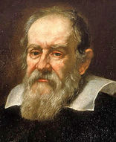
“Mathematics is the language in which God has written the universe”
- Galileo Galilei

Slide 5
Machine learning (ML) algorithms have proven highly accurate for identifying Randomized Controlled Trials (RCTs) but are not used much in practice, in part because the best way to make use of the technology in a typical workflow is unclear. In this work, we evaluate ML models for RCT classification (support vector machines, convolutional neural networks, and ensemble approaches). We trained and optimized support vector machine and convolutional neural network models on the titles and abstracts of the Cochrane Crowd RCT set. We evaluated the models on an external dataset (Clinical Hedges), allowing direct comparison with traditional database search filters. We estimated area under receiver operating characteristics (AUROC) using the Clinical Hedges dataset. We demonstrate that ML approaches better discriminate between RCTs and non-RCTs than widely used traditional database search filters at all sensitivity levels; our best-performing model also achieved the best results to date for ML in this task (AUROC 0.987, 95% CI, 0.984-0.989). We provide practical guidance on the role of ML in (1) systematic reviews (high-sensitivity strategies) and (2) rapid reviews and clinical question answering (high-precision strategies) together with recommended probability cutoffs for each use case. Finally, we provide open-source software to enable these approaches to be used in practice.
What kind of ‘basic’ data can you generate from this abstract?

Slide 6
Basic data generated from texts
Number of words
Number of characters
Average word length
Number of stopwords (e.g. the, that, is…)
Number of special characters* (e.g. %, -, (, )...)
Number of numerics
Number of uppercase words (e.g. RCT, ML, AUROC…)

Slide 7
Machine learning (ML) algorithms have proven highly accurate for identifying Randomized Controlled Trials (RCTs) but are not used much in practice, in part because the best way to make use of the technology in a typical workflow is unclear. In this work, we evaluate ML models for RCT classification (support vector machines, convolutional neural networks, and ensemble approaches). We trained and optimized support vector machine and convolutional neural network models on the titles and abstracts of the Cochrane Crowd RCT set. We evaluated the models on an external dataset (Clinical Hedges), allowing direct comparison with traditional database search filters. We estimated area under receiver operating characteristics (AUROC) using the Clinical Hedges dataset. We demonstrate that ML approaches better discriminate between RCTs and non-RCTs than widely used traditional database search filters at all sensitivity levels; our best-performing model also achieved the best results to date for ML in this task (AUROC 0.987, 95% CI, 0.984-0.989). We provide practical guidance on the role of ML in (1) systematic reviews (high-sensitivity strategies) and (2) rapid reviews and clinical question answering (high-precision strategies) together with recommended probability cutoffs for each use case. Finally, we provide open-source software to enable these approaches to be used in practice.
Can you still ‘know’ what this about?

Slide 8
Basic pre-processing (cleaning)
Lower casing
Punctuation removal
Stopwords removal
Frequent words removal
Rare words removal
Spelling correction
Tokenization
Stemming
Lemmatization
Remove unnecessary words
Tidy words to be recognized

Slide 9
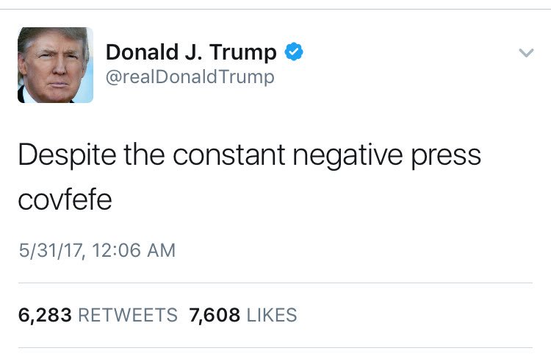


Slide 10
Advance Text Processing
N-grams
Term Frequency
Inverse Document Frequency
Term Frequency-Inverse Document Frequency (TF-IDF)
Bag of Words
Sentiment Analysis
Word Embedding

Slide 11
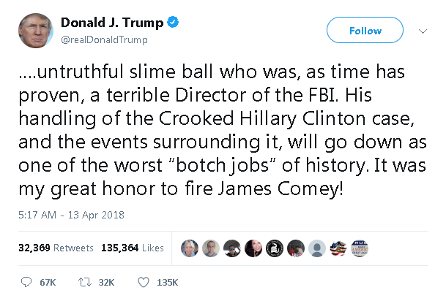

Slide 12
Practical
1. Convert your results into .csv file
2. Open your Excel file and move to ‘Results’ tab
3. Save as CSV/ UTF-8 (comma delimited) and renamed as ‘AutoSession2’ or any name you like
Open Jupyter Notebook/Lab on your computer
Drag/upload all contents into the folder on Jupyter home page
Remember to upload/replace your own AutoSession2.csv in the folder if you got your own!
Click ‘Run’ to see how codes work step by step and output your own results!
P.S. you might to need to overcome some package installation yourself! Good luck with it!

Slide 13
Take home messages
Text data can be described by mathematic formats or themselves
Basic statistics, TF-IDF, word embedding
Bag of words
These attribute to different strategies to be used in terms of analysing text data
Different external corpora can be used for processing text data
NLTK (i.e. Brown Corpus)
Use of these corpora in the data cleaning and processing can significantly affect the quality of text data and later analyses

Slide 14
Garbage in,
garbage out.

Slide 15
Homework
Basic Python use
https://www.codecademy.com/learn/learn-python
https://www.tutorialspoint.com/python/index.htm
UoB ACRC Python 1: Beginning Python
UoB ACRC Python 2: Intermediate Python
Text-mining packages to try out
Sklearn
nltk
Gensim
TextBlob
Questions and challenges
What is the pros/cons of using TF-IDF, bag of words and word embedding to analyse text data?
How will you utilise your results (decisions and/or terms) to find important/similar references?
Can you use other information of references to help the analysis? (i.e. authors or PMID)
Can you build your own corpora to help your data processing?

Slide 16
Thank you for coming!
Any questions please e-mail:
Kazeem b.k.olorisade@bristol.ac.uk
Vincent Vincent.Cheng@bristol.ac.uk

